Slide 1
Algorithms Propagate Gender Bias in the Marketplace—with Consumers’ Cooperation
Prof. Shelly Rathee
Prof. Sachin Banker
Prof. Arul Mishra
Prof. Himanshu Mishra

Slide 2
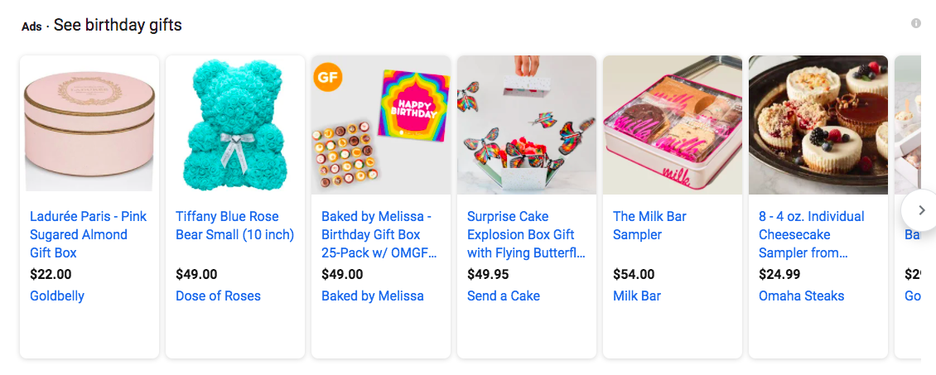
GOOGLE’S PRODUCT RECCOMENDATION FOR BIRTHDAY GIFTS
Is it possible that you are recommended different products based on your gender?
What products you are recommended when you enter the keyword “birthday gifts’?
Notes:
Let’s take an example of how algorithms can give rise to “consumption bubbles” for its customers.
Consider the scenario of shopping for birthday gifts. You go online on Google Shopping Website and you enter the keyword “birthday gifts”.
Google shows numerous products from different websites.
These websites generally have very little information about the consumers' past travel habits or preferences, aside from demographic information like age and gender that Google shares with them.
In such situations, the listings of ads are likely to be based on what the algorithms have learnt about consumers by mining text.
It is known that algorithms mine online text to group customers into segments and make predictions about them.
If that is true, then is it possible that women are more likely to see that are frivolous & indulgent like chocolates and cookies compared to men?

Slide 3
WHAT IS MARKETPLACE GENDER BIAS? When psychographic traits are related to men versus women: Positive traits = rational, loyal, innovative, determined Negative traits = irrational, fickle, lazy, unreliable
Marketers use these traits for Segmentation and Targeting their consumers
Notes:
In Computer Science field, a lot of research has already shown the prevalence of gender bias in online text. For instance, men are associated with more positive words such as love, cheer, and peace while women are instead associated with negative words such as murder, filth, and evil.
But none of the research has shown gender bias in the context of marketplace. In other words, how are marketplace psychographic traits related with men versus women? This is important because marketers use these traits for segmentation and targeting their consumers.

Slide 4
RESEARCH QUESTIONS
ONLINE
TEXT
Whether online algorithms learn marketplace gender bias from online text?
Would it influence outcomes for consumers? Would there be any adverse effects on female consumers?
DETECT BIAS
ALGORITHMS
GETS REFLECTED
OUTPUT
(RECCOMNEDATIONS & ADS)

Slide 5
METHODOLOGY
To detect marketplace gender bias in online text:
Publicly Available Data: Common Crawl
Used Natural Language Processing (word-embedding's) to detect implicit associations
Used Similarity measure to find out how men vs. women are associated with positive vs. negative traits.
To examine biases in algorithms’ output/outcomes
Field experiments on Facebook and Google conducted
Dependent Variable: How advertisements and product recommendations change by online algorithms?
Independent Variable: Positive and Negative traits are manipulated in an advertisement.

Slide 6
RESULTS FOR COMMON CRAWL DATASET
Similarity (male words to positive attributes)
-
Similarity (male words to negative attributes)
Similarity (female words to positive attributes)
-
Similarity (female words to negative attributes)
0
Men significantly had greater semantic similarity with positive traits (2.485) than women did (2.083; d=.763, p<.001).
Women had significantly greater semantic similarity with negative traits (1.879) than men did (1.837; d=.154, p<.001).

Slide 7
Therefore, algorithms learned that women are more likely to be "tempted", "fragile", "irresponsible", “fickle", "dissatisfied", "conformist”
than
“rational” , "disciplined", "loyal", "trustworthy", "patience", "creative", "innovative”

Slide 8
RESULTS FROM FIELD EXPERIMENT
100%
90%
80%
70%
60%
50%
40%
30%
20%
10%
0%
87%
80%
IV: Positive vs. Negative Ads
DV: Impressions (who was targeted to see the advertisement)
20%
13%
POSITIVE
NEGATIVE

Slide 9
CONTRIBUTIONS AND ETHICAL IMPLICATIONS
Notes:
This research has the potential to mitigate the negative consequences of gender-biased algorithms in the marketplace; greater awareness of the existence of these biases would encourage consumers to seek out alternative sources of information. Because consumers trust and rely on personalized recommendations, educating them about biases in online ad delivery can foster healthy skepticism.
Also, the findings have significant ethical, legal, and policy ramifications. Firms routinely use algorithms to gather insights and then base their decisions on these insights. Because algorithms influence so many aspects of consumer decision-making, they should not be accompanied by the risk of caveat emptor. Because consumers are largely unaware of how ad-targeting algorithms can limit their access to goods and services, and because they may be unable to independently discover such biased offerings due to limited human processing capacity, it is critical for firms to consider fairness objectives alongside ad efficiency and optimization objectives.

Slide 10
Shelly Rathee
shelly.rathee@villanova.edu
Sachin Banker
sachin.banker@utah.edu
Arul Mishra
arul.mishra@utah.edu
Himanshu Mishra
himanshu.mishra@utah.edu

