Slide 1
Secret consumer behaviors in close relationships
Research by Danielle J. Brick, Kelley Gullo Wight, and Gavan J. Fitzsimons
Published in the Journal of Consumer Psychology

Slide 2
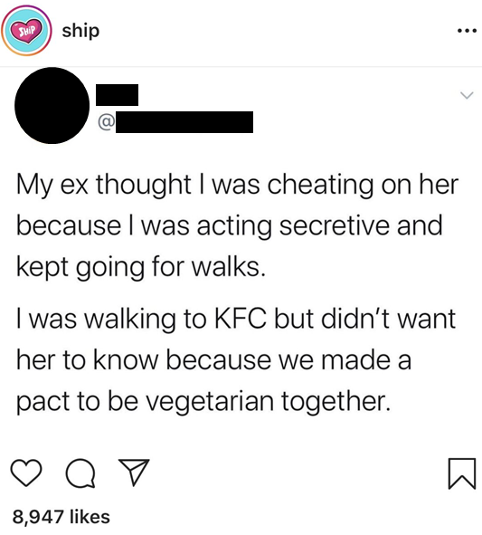
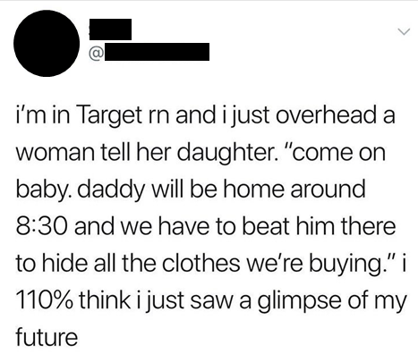
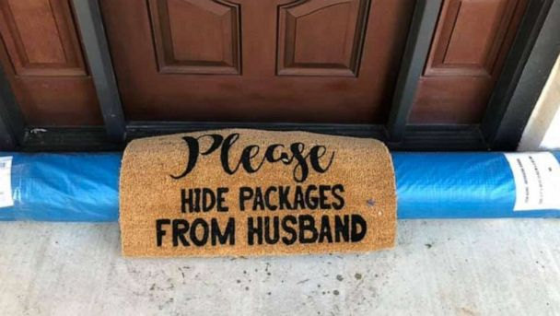
Secret consumer behavior
Consumers don’t always tell others about their consumption.
Sometimes they intentionally keep it a secret.

Slide 3
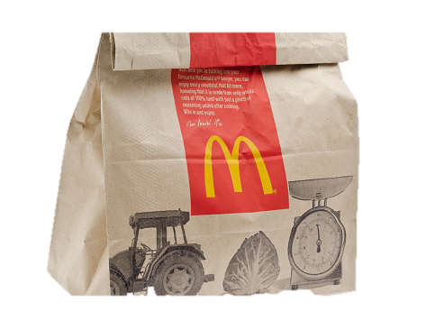
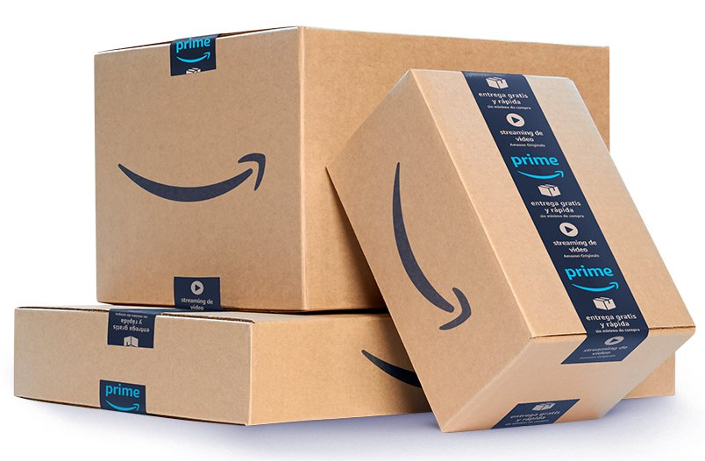
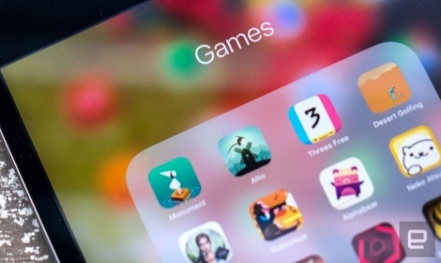
What kind of consumer behaviors do people keep as secrets?
Keeping consumption secrets is common
~90% of people reported a recent consumption secret
People tend to keep ordinary, everyday consumption as a secret
Examples: fast food, Amazon purchases, video games, hiring maids, etc.
They report that the consumption they keep secret is not a big deal and that people wouldn’t care about the consumption if the secret was found out
In fact, they often report having done the consumption in front of or with others in the past
It’s not always done in secret
ACROSS TWO SURVEYS OF ~300 TOTAL PEOPLE, THE RESEARCHERS FIND THAT:

Slide 4
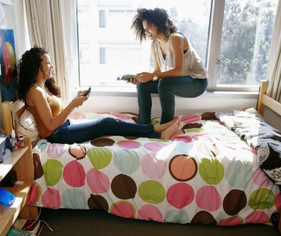
Who do people keep their consumption secrets from?
IN A SURVEY OF ~100 PEOPLE, THE RESEARCHERS FIND THAT:
People tend to keep their secret from a specific close other
They tend to not keep their consumption secret from everyone in general
And tend to not keep them from acquaintances

Slide 5
How does keeping consumption secrets affect the relationship?
TO ANSWER THIS QUESTION, THE RESEARCHERS CONDUCTED THREE EXPERIMENTS:
In all experiments, half the participants imagined intentionally keeping a consumption secret from their romantic partner
The other half of participants served as the comparison group, so they imagined not keeping a consumption secret by:
Experiment 1: telling their partner about the consumption
Experiment 2: forgetting to tell their partner (as opposed to intentionally keeping a secret)
Experiment 3: not engaging in the consumption at all
In experiment 1, participants described what they would purchase online as the focal consumption
In experiments 2 and 3, participants described what they would order from a coffee shop as the focal consumption

Slide 6
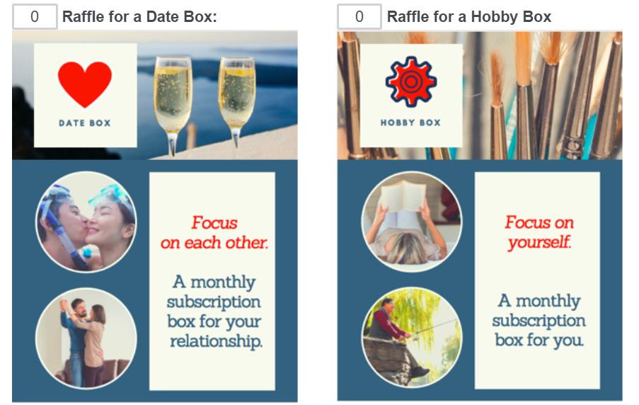
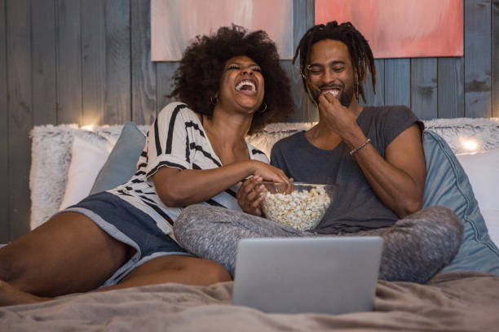
How does keeping consumption secrets affect the relationship?
ACROSS THE THREE EXPERIMENTS OF ~1000 TOTAL PEOPLE, THE RESEARCHERS FIND THAT:
Secret-Keepers slightly guilty for keeping a secret from a close other
They feel this way even though they don’t think the other person would care
Guilt has a strong psychological effect: it makes secret-keepers want to make it up to their relationship partner
As a result, secret-keepers invest more time and money into their relationship after keeping a consumption secret
In experiments 1 and 3, participants were given 15 raffle tickets to distribute across two real raffles. Secret-keepers were more likely to invest more raffle tickets into a raffle with a Date Box prize.
In experiment 2, secret-keepers were more willing to invest time into their relationship by watching their partner’s favorite movie together instead of spending time doing what they wanted to do.

Slide 7
Takeaways and Implications
For Consumers:
For Marketers:
Small, everyday consumption secrets can be beneficial for your relationships
Of course, this doesn’t mean that all secrets are good. Lots of research shows that big secrets lead to bad psychological and relationship outcomes.
Your secret chocolate stash may be helping your relationships!
Marketers should include questions about secret consumption in their market research to more fully understand the behavior of their consumers
Secret consumption is a very common consumption context for many products and services
Marketers can encourage secret consumption without risk to word of mouth
People tend to not keep their consumption secret from a specific other, and not from everyone in general
People tend to do the consumption in secret only sometimes. Other times it’s not a secret.

Slide 8
Author Contact Information
Dr. Danielle J. Brick, Ph.D. (danielle.brick@uconn.edu)
Dr. Kelley Gullo Wight, Ph.D. (kgullo@iu.edu)
Dr. Gavan J. Fitzsimons, Ph.D. (gavan@duke.edu)

