Slide 1
Bracing for the Sting of Disposal: Product Purgatories Encourage Mental Simulation of the Disposal Process
Mathew S. Isaac Seattle University
isaacm@seattleu.edu
Poornima Vinoo Indian School of Business
Poornima_Vinoo@isb.edu
Journal of Consumer Psychology
https://doi.org/10.1002/jcpy.1342

Slide 2
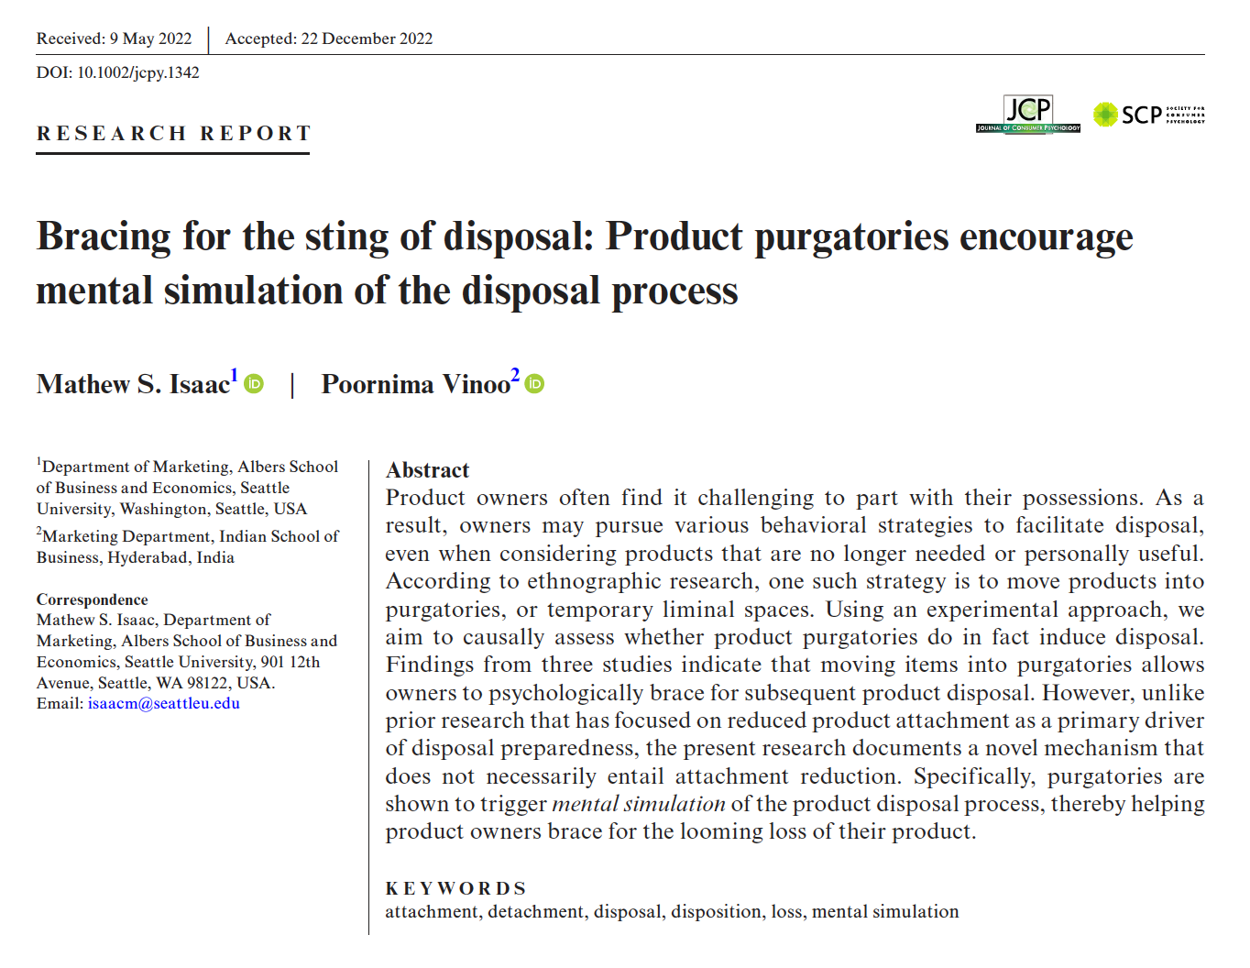

Slide 3
Product Purgatories
A “consumption limbo” or liminal space for products that are not actively being used (Suarez et al. 2016, p. 420)
Less visible, non-central “marginal” places, such as a storage unit, box, or shelf in a closet, attic, garage, basement
Owners who choose to retain possessions often move them into a product purgatory (Lastovicka and Fernandez 2005; Roster 2001; Suarez et al. 2016)

Slide 4
Do Purgatories Facilitate Disposal?
Maybe Not!
Because purgatories are typically in locations with low visibility and limited daily traffic, products in purgatories are not taking up valuable real estate in the home
As a result, product owners may feel less compelled to take an action (e.g., disposal) that frees up the space assumed by a product already in a purgatory.
Maybe!
Purgatories are “divestment rituals” that make it easier to dispose of an object (Lastovicka and Fernandez 2005)
Evidence for this claim is largely anecdotal and based on a small number of informants (Lastovicka and Fernandez 2005; Roster 2001; Suarez et al. 2016)

Slide 5
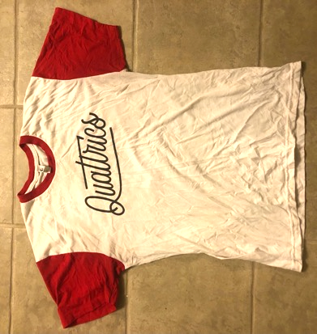
If So, Presumption is that Purgatories Also Reduce Product Attachment
Purgatories “instigate and perpetuate the sometimes slow and insidious process of physical and emotional detachment from a possession.” (Roster 2001, p.427)
Consistent with prior work in other contexts showing that attachment reduction is an antecedent to disposal readiness (Lastovicka and Fernandez 2005; Roster 2001; Winterich, Reczek, and Irwin 2017)

Slide 6
Research Objectives
To employ an experimental paradigm to assess whether the presence of a product purgatory encourages subsequent disposal
To evaluate whether purgatories facilitate disposal by reducing attachment or if another psychological mechanism may be at play

Slide 7
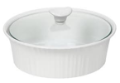
Overview of Experiments
 | Experiments | Sample
 | Pilot Study | N = 149 MTurk Cloud Research
 | Experiment 1 | N = 247 MTurk Cloud Research
 | Experiment 2* | N = 299 Prolific Academic
 | Experiment 2 Replication | N = 606 MTurk Cloud Research
 | Experiment 3 | N = 423 Cloud Research
* Preregistered

Slide 8
Experiment 1 Stimuli
[Product Purgatory Present Condition]
It is very important that you now move the item to another room, garage, or basement. You will need to take a photo of the item in this location.
[Product Purgatory Absent Condition]
It is very important that you now leave the item in its current location in the kitchen. You will need to take a photo of the item in this location.

Slide 9
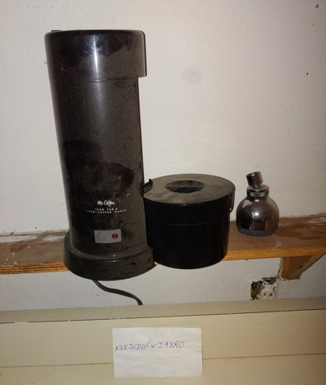
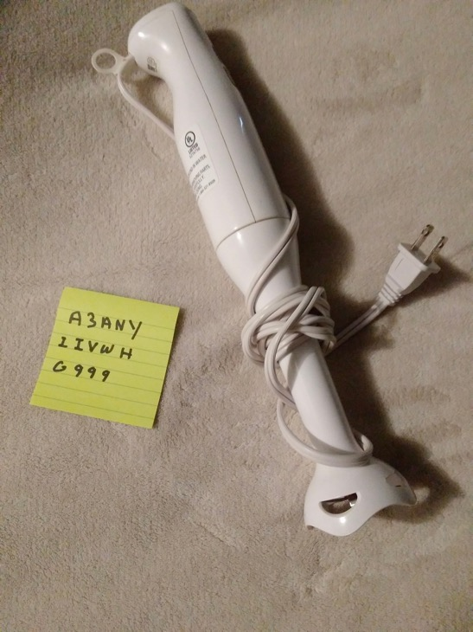
Experiment 1 Results

Slide 10
Experiment 1 Results
χ²(1) = 6.31, p = .012, φ = .16

Slide 11
Mental Simulation, not (necessarily) Attachment Reduction!
We also find that the mere act of moving an item into a purgatory (not just moving it anywhere) prompts product owners to mentally envision its permanent disposal
Actively imagining a future event forms a link between thought and action, leading consumers to define an objective and create a path towards achieving it (Pham and Taylor 1999)

Slide 12
Contributions
We provide clear and causal evidence that product purgatories lead to disposition of items that owners use infrequently, yet are reluctant to give up
Our work cautions researchers who aim to help consumers dispose of unneeded items from focusing solely on interventions that reduce emotional attachment

Slide 13
Bracing for the Sting of Disposal: Product Purgatories Encourage Mental Simulation of the Disposal Process
Mathew S. Isaac Seattle University
isaacm@seattleu.edu
Poornima Vinoo Indian School of Business
Poornima_Vinoo@isb.edu
Journal of Consumer Psychology
https://doi.org/10.1002/jcpy.1342

