Slide 1
Home and Psychological Well-being in Global Consumer Mobility
Zahra Sharifonnasabi, Queen Mary University of London, UK
Laetitia Mimoun, ESCP Business School, Paris, France
Fleura Bardhi, Bayes Business School, City University London, UK

Slide 2
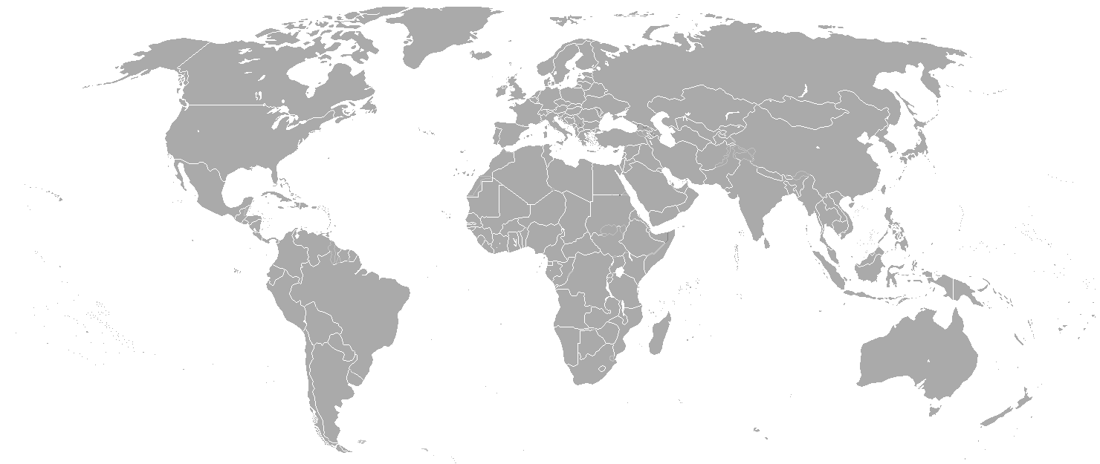

Study motivation: Developing a single, stable home is challenged in global mobility
“Emotional home”. Spends 2 months/year
Extensive domestic activities (e.g., DIY)
Strong familial and social relations
Owns a house. All material possessions (e.g., DVDs, books, music instruments) are stored
“Home away from home”. Permanent work contract, spends 7 months/year
Routine-based domestic activities (e.g., meal prep, chores)
Selective social relations and commercial friends
Symbolic material possession (e.g., rug symbolizing family home)
London
Berlin
Dubai
“Base of operation”. Spends 2.5 months/year
Outsourced domestic activities (e.g., take-out food)
Professional social relations
Access-based residence (e.g., hotel apartment), Limited possessions. No shopping beyond necessity
Adam
62 years old, born in Germany
Education: MSc
Speaks 3 languages
Married with 2 kids, family lives in Berlin

Slide 3
The consumer psychology problem
Prior consumer research
Perceives home as a singular and sacred place, often tied to a place (e.g., the house) and a nation-state.
Argues that consumers must dwell for a long time and develop an attachment to their home
Assumes that without a home consumers feel rootless, disoriented, and lacking an anchor for key social connections and identity, thus experiencing a diminished sense of well-being (Eichinger et al. 2022; Hill 1991; Mehta and Belk 1991).
In global mobility
Developing a single, singularized place to call home is challenged
Consumers develop and maintain multiple homes some of which lack the materiality, emotional attachment, and sense of ownership typically identified as essential elements of a home.
RQs: What are the meanings of home for globally mobile individuals, especially in relation to consumption practices, possessions, and ownership? How does the multiplicity and fragmentation of home in global mobility impact consumers’ well-being and identity? How do consumers cope with the psychological consequences of this multiplicity and fragmentation?

Slide 4
Three theoretical perspectives on home
Place based perspective on Home
Is associated with a physical structure –a house– and the material manifestations of dwelling (e.g., home ownership, possessions) (Mallet 2004).
Often implies a singular place, enclosed, stable, and private (McCracken 1989)
Drives a sense of psychological ownership, national identity, and groundedness.
Space based perspective on Home
Is constituted by the social interactions among the group of people who occupy the space and produce social institutions (e.g., family, household).
Implies ‘feeling at home’ not necessarily in a particular place, but when we are with those whom we love (e.g., family, friends, community)
Drives a sense of emotional attachment, belonging, and rootedness in the world.
A Practice based perspective on Home
Is understood as a set of organized, intentional, and thoughtful acts of doings.
Is shaped less by the place and more by the homemaking practices that give meaning to the place (Ellingsen and Hidle 2013).
Drives a sense of continuity in conditions of change (e.g., global mobility).

Slide 5
Study method
We conducted a qualitative study by combining phenomenological interviews and ethnographic observation.
Sample information:
We define global mobility as a certain type of international mobility where consumers live and travel across borders and relocate internationally frequently. Through this ongoing movement between two or more countries, consumers spend enough time in each location to identify an accommodation as a home
Sample includes globally mobile consumers in long-distance family arrangements, long-distance company assignments, expats, and transnational professionals.
Sample excludes traditional migrants, short-term travelers, and involuntary mobility (e.g., refugees).
Sample size: 40

Slide 6
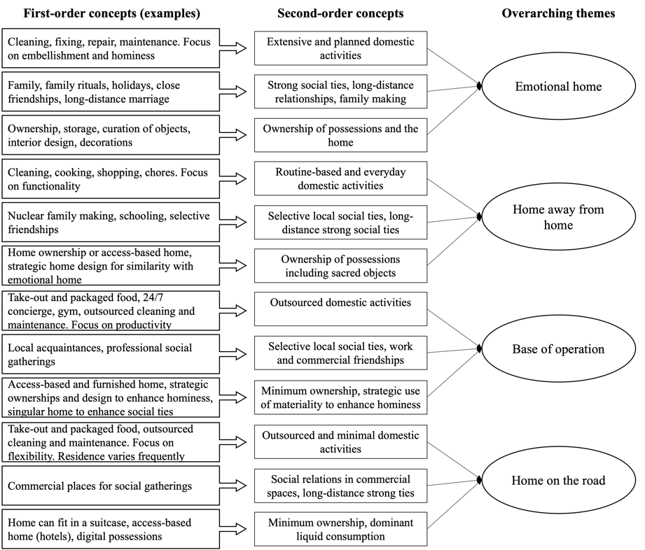
Summary of the Data Analysis Process
Gioia, Corley, and Hamilton 2013

Slide 7
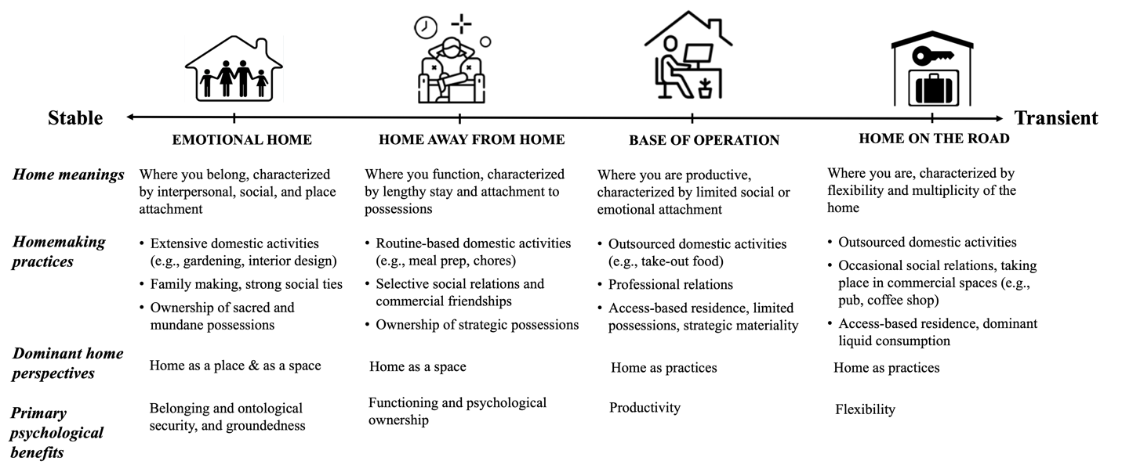
Findings (1): A Typology of Home in Global Consumer Mobility

Slide 8
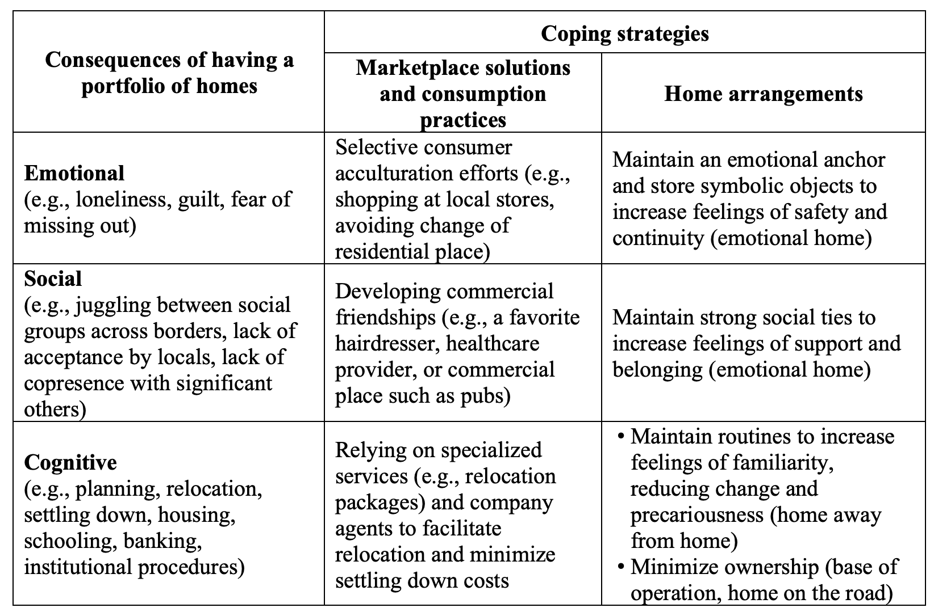
Findings (2): Portfolio of Homes’ Consequences and Coping Strategies

