Slide 1
Money Can Buy Me Love
Gifts are a more effective form of acute social support than conversations
Holly Howe, HEC Montreal
Hillary Wiener, SUNY Albany
Tanya Chartrand, Duke University

Slide 2
We study support given to someone experiencing an acute stressor, like a break-up or a job loss
We study emotional support—support that is intended to improve the receiver’s emotional state, without solving their problem
If someone is having a hard day, is it more effective to emotionally support them with a gift or a conversation?
Conversational support: Two people having a multi-turn interaction wherein the support receiver expresses negative emotions, is reassured about their ability to cope, and seeks comfort.
Gift: A product willingly given from one person to another without the expectation of payment.
(Barbee & Cunningham, 1995; Feeney & Collins, 2015; Oxford English Dictionary, 2023)
Notes:
when we refer to gifts in this paper, we mean
products (because experiences often involve conversations) that are
relatively affordable (i.e., of similar cost to conversations when time is converted to money)
provide non-tangible support (i.e., are no more effective than a conversation at solving the receiver’s problem),
of moderate quality (i.e., of similar quality to conversational support).
In theory many things can be emotionally supportive gifts, but in practice support gifts are fairly codified. Food, flowers, and aromatherapy items are common. Indeed, in a recent Hello! Magazine article suggesting 49 gifts to cheer up a friend, 10 (17%) were food, 9 (15%) were aromatherapy (e.g., candles, bath soaks), and 3 (5%) were flowers (Bayley, 2023).

Slide 3
Gifts are a more effective form of emotional support than conversations.
Why?

Slide 4
How does emotional support work?
The enjoyment path
Greg is happier because he enjoys the gift / conversation
Greg is happier because he feels valued and loved within the friendship
The love path

Slide 5
Gifts outperform conversations on the love path—because recipients perceive gifts as a larger sacrifice than conversations
Gifts outperform conversations on the enjoyment path—because gifts are a surprising distraction from negative emotions
…

Slide 6
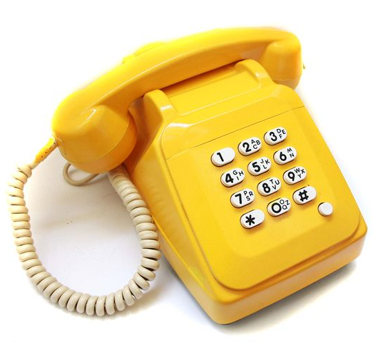
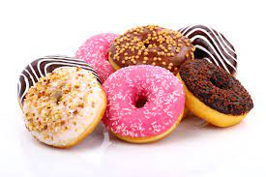
Methods I
Participants (N = 735) imagined being in a minor (no injuries, not at fault) car accident. They reported pre-support negative emotions, then imagined texting a friend for support.
“ [Name] calls you and says that they are sorry your day is awful and that they are there for you. They express sympathy and try to provide comfort. You talk with them for a while”
“[Name] sends you a link to Uber Eats which shows that a delivery driver is on their way to you with a treat from your favorite dessert shop.”
Participants reported post-support negative emotions

Slide 7
Methods II
Sacrifice |  | Thoughtfulness |  | Surprise |  | Distraction
My friend… Made a sacrifice for me Gave up something to support me |  | To what extent do you believe that your friend acted in a way that is... Thoughtful Caring Considerate |  | To what extent were you _______ by your friends’ response Surprised Astonished |  | In this scenario, to what extent did your friend... Distract you from your situation Make you think about something else

Slide 8
Results: Effect on Emotional Recovery
F(1, 733) = 136.80, p <.001, η_{p}² = .16

Slide 9
Results: Effect on Mediators
***
***
***
***
Overall MANOVA: F(1, 733) = 254.74, p<.001

Slide 10
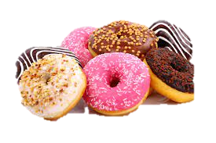
The love pathway
It seems like more of a sacrifice
Which makes the support seem more thoughtful
The enjoyment pathway
When an upset person gets a gift (vs. a conversation)…
Which makes them feel better!
They feel more surprised
Which distracts them

Slide 11
Author Contact Info
Holly Howe, holly.howe@hec.ca
Hillary Wiener, hwiener@albany.edu
Tanya Chartrand, tanya.chartrand@duke.edu

