Slide 1
The Ironic Impact of Schadenfreude
When the Joy of Inflicting Pain Leads to Increased Prosocial Behavior
Yael Zemack-Rugar, Laura Boman, and Thomas Kramer

Slide 2
Motivation
Appeals that involve inflicting misfortune on another are highly popular at the national, local, and grassroots level.
Are they effective?

Slide 3
Are they effective?
On the one hand, they may be viewed as sadistic and immoral, reflecting poorly on the consumer and the charity.
On the other hand, enjoying the misfortune of another (i.e., schadenfreude) can be socially acceptable, and is a positive emotion, which can potentially increase donations.
Which is it?

Slide 4
Deservingness
Severity
Enjoying the misfortune of another is morally appropriate when the target of misfortune is deserving (e.g., misbehaved previously).
Enjoying the misfortune of another is morally appropriate when the misfortune is mild, and there is no real harm to the target.
It depends
(prior research)
Passivity
Enjoying the misfortune of another is morally appropriate when the observer had no active role in inflicting misfortune; rather, misfortune occurred by happenstance.

Slide 5
Deservingness and Severity
The first two conditions must hold, because they ensure that the misfortune provides interpersonal justice, by delivering not-overly-severe punishment to misbehaving (i.e., deserving) targets.
It depends
(Current research)
Passivity
The third condition is unnecessary.
Actively inflicting mild misfortune on a deserving target delivers justice, and thus is morally acceptable, and consistent with schadenfreude, and is not sadistic.

Slide 6
This is why (and When)
Misfortune involving appeals work
Allow consumers to deliver mild misfortune
To targets that are deemed deserving of that misfortune
Eliciting joy in the target’s misfortune (i.e., schadenfreude)
This joy (and not sadism) drives increased willingness-to-donate
Resulting in doubling donations!

Slide 7
TAKEAWAYS: HOW CAN YOU USE SCHADENFREUDE?
Since we demonstrate that schadenfreude occurs not only when consumers passively observe misfortune, but also when they actively inflict misfortune, it is likely that schadenfreude plays a role in many consumer contexts, heretofore overlooked:
In reality TV, when consumers impose punishment on a disliked contestant.
In investments, when consumers drive the prices of stocks down to harm disliked companies.
In politics, when consumers spread fake news to harm a disliked candidate.
In branding, when consumers share negative WOM to get a disliked company or brand to fail.
Marketers should carefully consider the role of schadenfreude and its impact in donation appeals and beyond!

Slide 8
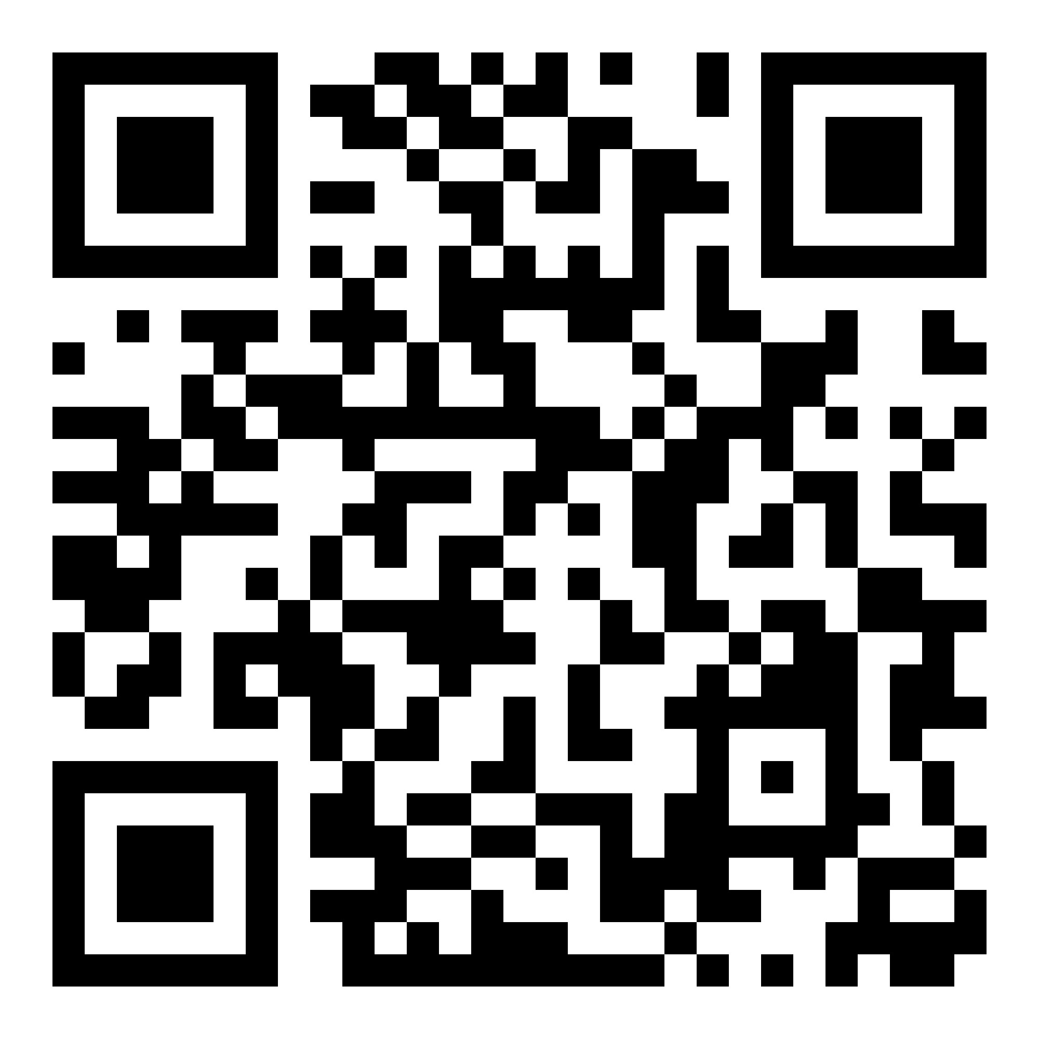
Author Contact Information
Yael Zemack-Rugar, PhD
Laura Boman, PhD
Thomas Kramer, PhD
yael@ucf.edu
lboman@kennesaw.edu
thomas.kramer@ucr.edu
Find the full article here:
Credits: This presentation’s general layout, background, and some images were generated using beautiful.ai; other images were generated using Adobe Firefly AI image generator; others still were created by a graphic designer. All content was created by the authors.

