Slide 1
The Mobile Giving Gap: The Negative Impact of Smartphones on Donation Behavior
Stefan Hock, Kristen Ferguson, Kelly Herd

Slide 2
Motivation
Online giving is on rise.
Donations made on electronic devices (i.e., smartphones and PC) have grown by 42% since 2019
Mobile donations (i.e., made on smartphones) have more than tripled since 2014
We were curious about how different device types influence donation behavior
Notes:
Image 1: https://www.heraldtribune.com/story/news/education/2020/03/26/coronavirus-florida-lee-teachers-zoom-new-norm-virtual-learning/2901854001/
Image 2: Generated with AI/Dall-e – images not credited in later slides were also generated by AI/Dall-e

Slide 3
The Consumer Psychology Problem
Charities typically utilize identical appeals when targeting consumers across devices
But: charities may be leaving money on the table by using a one-size-fits-all strategy for all forms of online giving

Slide 4
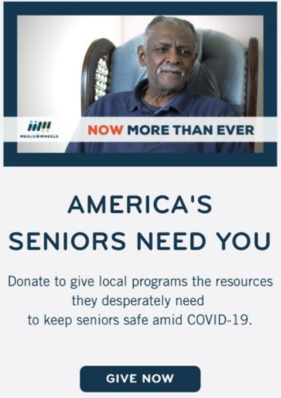
Research Question
Does device type influence donation behavior?
vs.

Slide 5
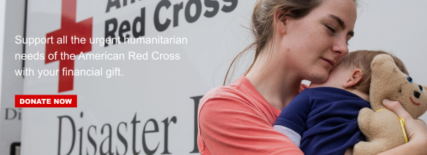
Relevant Method and Study Information
Utilized a combination of lab and Google Ads experiments
We randomly assigned participants to either a smartphone or PC
Across studies, we used different charities (e.g., The American Red Cross, The Salvation Army) and dependent variables (e.g., donation likelihood, clickthrough rate)

Slide 6
Key Results
People are less likely to engage in charitable behavior on their smartphone (vs. PC) → “mobile giving gap”
Why? People are more self-focused on their smartphone and when they are more focused on themselves (vs. others), they are less likely to engage in charitable behavior
Charities can close the “mobile giving gap” by increasing other-focus when targeting smartphone users

Slide 7
Consumer Psychology Takeaways
Online giving is on the rise, but charities utilize a one-size-fits-all approach to target consumers
Consumers are less likely to engage in charitable giving, creating the “mobile giving gap”
Charities need to tailor their campaigns to the respective devices to close the gap and maximize donations

Slide 8
Author Contact Information
Stefan Hock: stefan.hock@uconn.edu
Kristen Ferguson: kfergus3@nd.edu
Kelly Herd: kelly.herd@uconn.edu

