Slide 1


The Charity Capacity Curse
Shirley Zhang
The University of Leeds
Thomas Allard
Singapore Management University
David Hardisty
University of British Colombia
Shane Wang
Virginia Tech

Slide 2
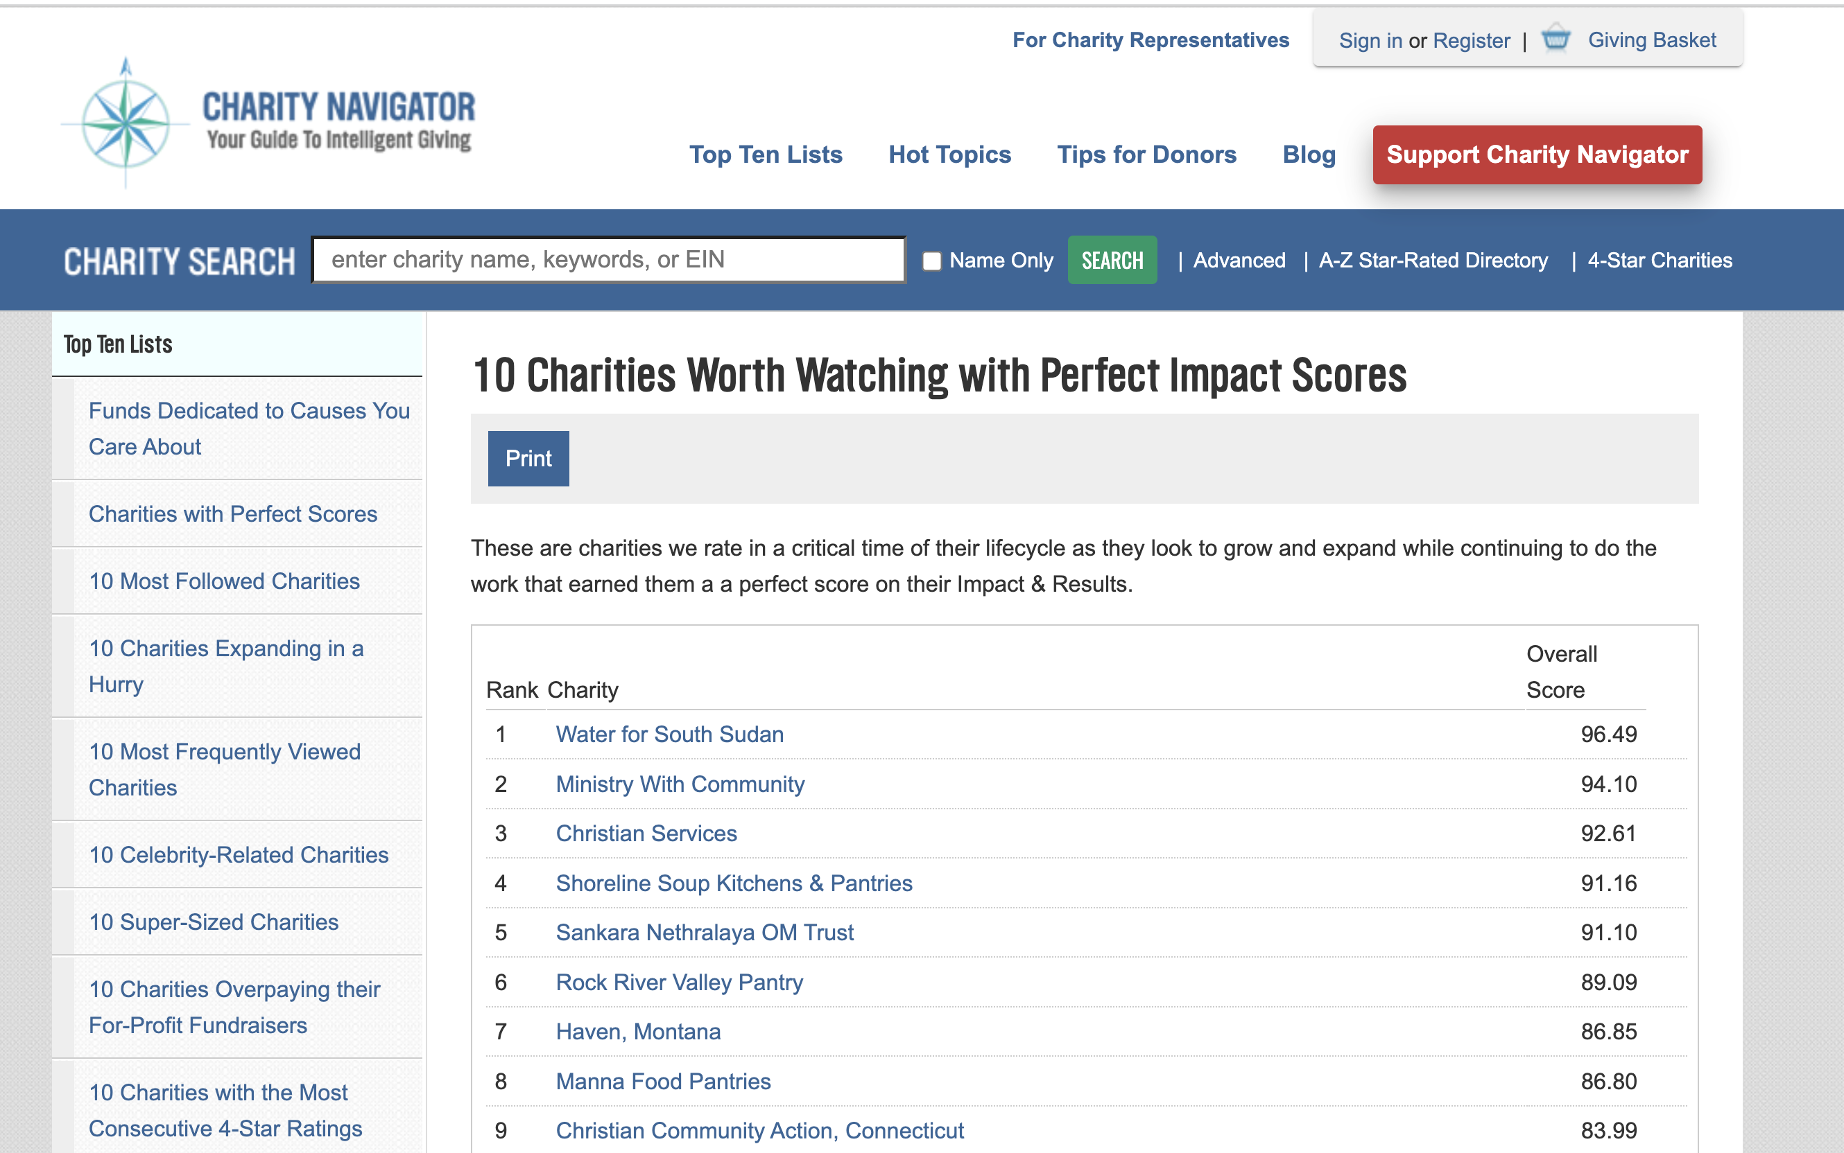

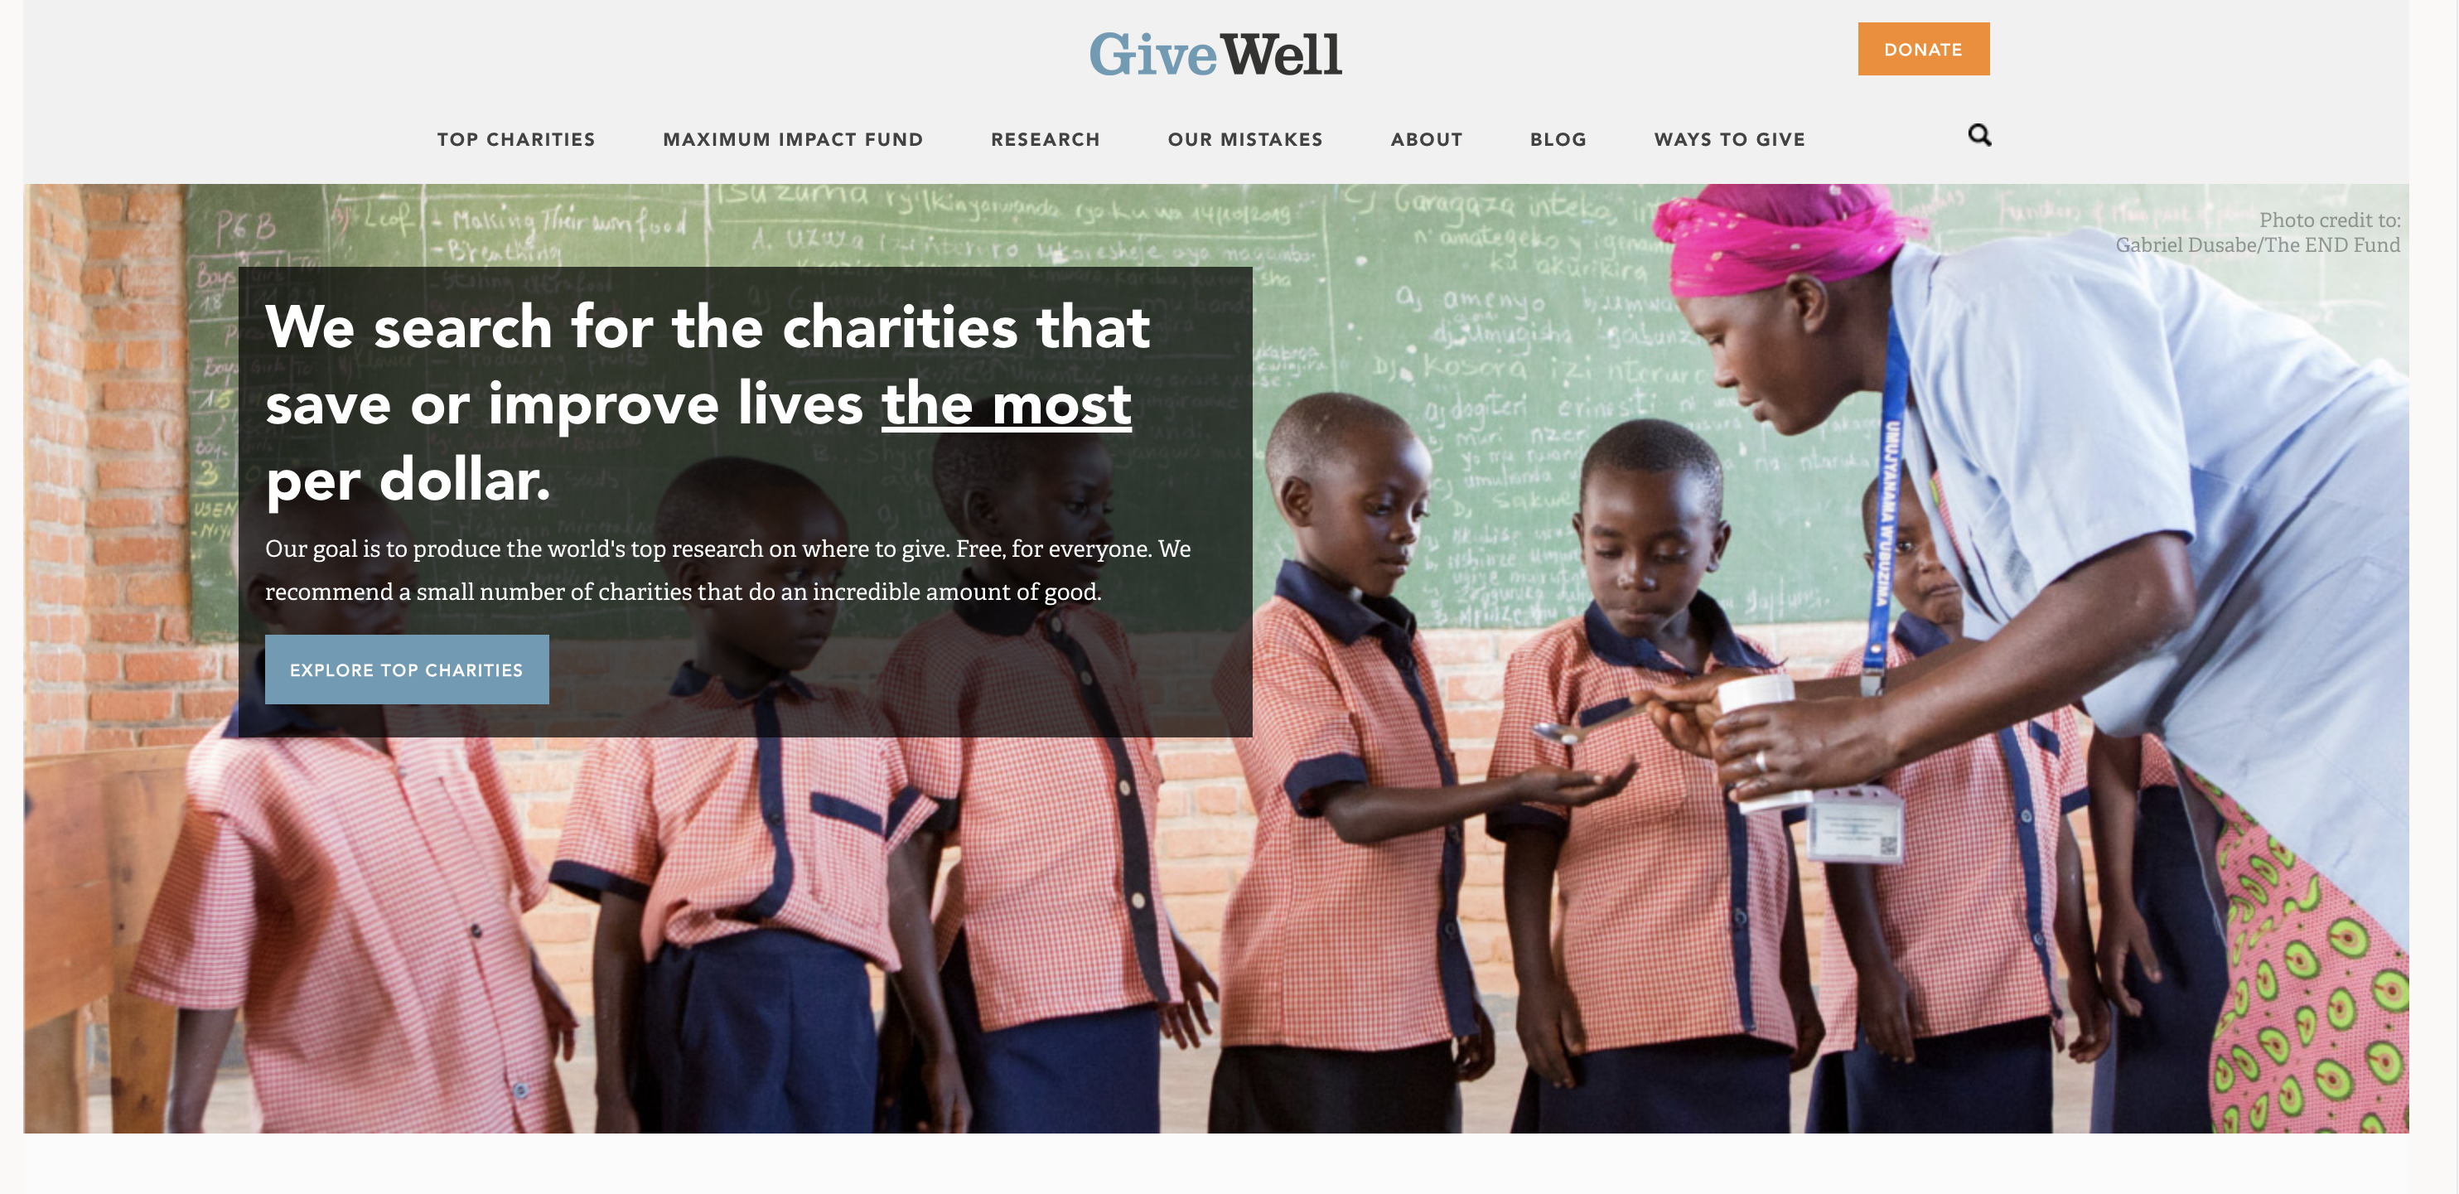
Motivation
Effective Altruism recommends donating to charities that maximize impact per dollar—most effective charities (MacAskill, 2015; Singer, 2009, 2015), because more effective charities do more good.
Thus, many charities try to highlight their effectiveness in their fundraising materials, and charity assessment tools such as charitynavigator and Givewell are made available to help donors identify the most effective charities.
This strategy seems intuitive. In many other domains, choosing airlines, banks, hospitals, people prefer more professional and capable providers.

Slide 3
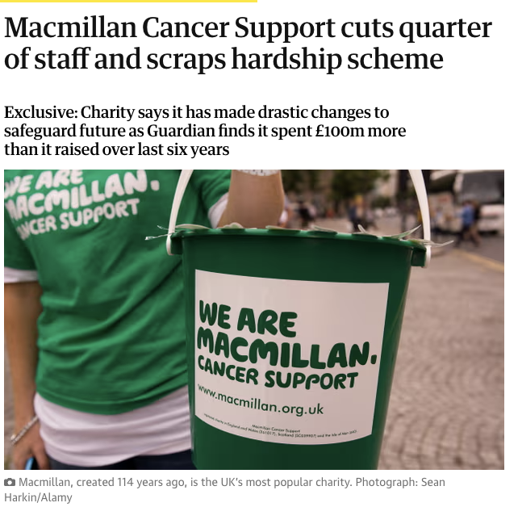
The Consumer Psychology Problem
But… despite being highly capable, many professional charities struggle to raise donations.
Real-world example: Macmillan Cancer Support, with 114 years of history and more than 1,200 specialist staff, cut 300+ roles in 2024 due to a decline in donations.
Why do charities appear more capable struggle to raise funds?
https://www.theguardian.com/society/2025/feb/13/macmillan-cancer-support-cuts-quarter-of-staff-and-scraps-hardship-scheme

Slide 4

Our Research Questions
Do signals of capacity cues (e.g., skilled staff, financial stability, operational scale) reduce donation intentions?
Why do people give less to higher-capacity charities?
Can this “Charity Capacity Curse” be mitigated?

Slide 5


How We Studied It?
Across 6 pre-registered experiments with thousands of participants
Participants read about charities described as either high or low in capacity.
We varied capacity signals: human resources, organizational operational scales, financial stability.
Measured perceived need and donation intentions/donation amounts.
Sample Stimuli
Lower-capacity
Higher-capacity

Slide 6


Key Findings
✅ Charity Capacity Curse
The more capable a charity appears, the less inclined people are to donate.
✅ Why?
Donors inferred: “They’re doing fine—they don’t need me.”
✅ How to Fix It:
When needs of the higher-capacity charity were made salient.
When people reflected on the impact of higher-capacity charity towards end-beneficiary, donations increased.

Slide 7

Implications for Non-Profit Communciations
✅ Lead with need, not capacity.
  It is often more effective to focus on unmet needs and to explain how a donor’s support directly addresses them.
✅ Frame capacity as a means, not an end.
  Rather than stating, "We have a highly experienced board," it is more effective to say, "Our board’s healthcare expertise allows us to deliver evidence-based programs and reach underserved patients faster."
✅ Tailor messages to the audience.
  Institutional donors tend to value strategy, metrics, and long-term planning. Individual donors are more likely to be moved by immediacy and emotional connection. Nonprofits must tell different stories to different audiences.

Slide 8

Thank You!
Contact: Shirley Zhang
L.zhang7@leeds.ac.uk

