Slide 1

Neighbors as Strangers or Friends?
How People’s Self-Construal Affects the Weight of Neighbor Information in Residence Decisions
Xingning (Fiona) Qu
Linying (Sophie) Fan
Fengyan Cai

Slide 2
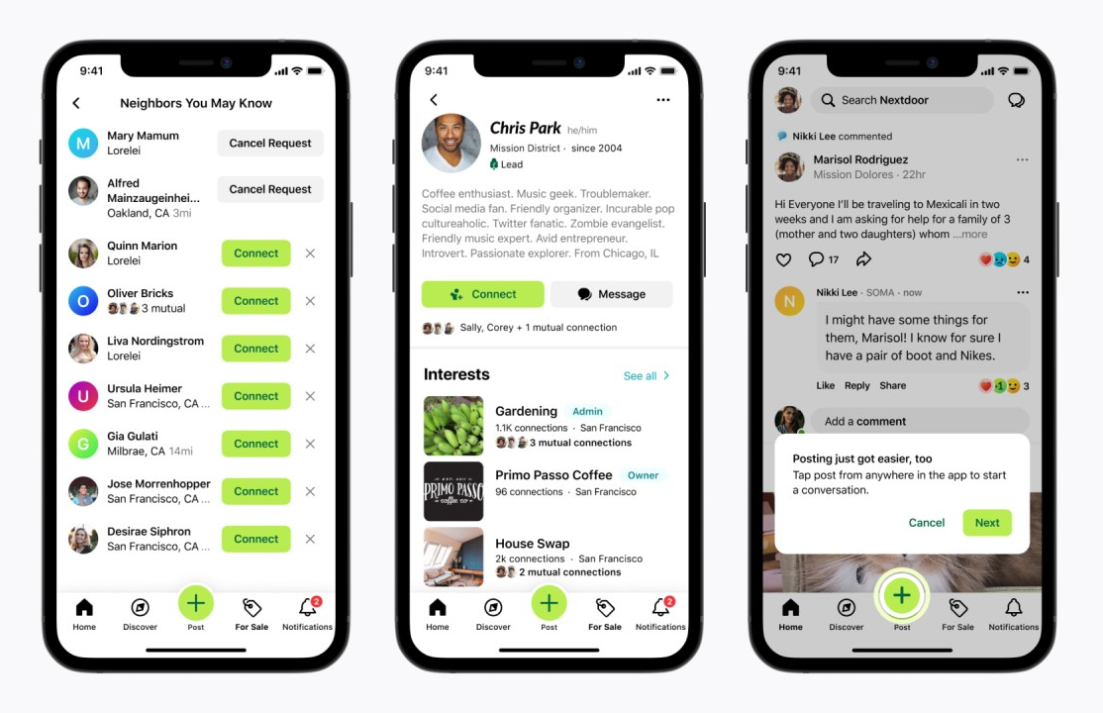
Motivation & Background
Neighbors matter
Consumers are paying closer attention to who lives next door
Neighbourhood apps & local groups show rising engagement
Nextdoor app

Slide 3
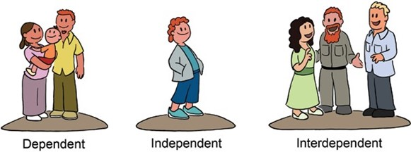

Research Question
Who care more about neighbor information?
vs
Independent
Interdependent

Slide 4

Independents Care About Neighbors, Why?
Pretest (N = 200): More people (67%) will see neighbors as outgroup.
Independents have a more flexible boundary and see less difference between ingroup and outgroup
Independent view
Independents seek to fulfill their social belonging needs through various means.
Interdependent view

Slide 5
Methods & Study Overview
Self-construal
Intended social closeness with neighbors
Weight of neighbor information
Study 2
Studies 1a-1c
Likelihood of making connection with neighbors
Neighbor preference
Study 3
Preference for similar neighbors
All studies pre-registered
Self‑construal measured or manipulated across samples
Study 4
Importance of the attributes of neighbor similarity
Study 5

Slide 6
Key Findings
Independent self-construal leads to…
Higher weight of neighbor information when evaluating residence (S1a-S1b)
Pay more attention to neighbor information (S1c, S2, S3)
Higher intended closeness with potential neighbors (S2)
Higher preference for neighbors that can be friend with (S4)
Higher evaluation on neighbor similarity that can facilitate friendship (e.g., similar hobbies; S5)

Slide 7

Takeaways & Implications
Self‑construal influence neighbor-related housing decisions
Independent consumers focus on neighbour information and future friendships.
Rethink listings and platforms as community builders. Highlight community cues: hobbies, activities, shared spaces, especially for independent people.
Marketers: Neighbor information isn’t trivial—it's a meaningful part of the housing decision.

Slide 8
Contact Information
Xingning (Fiona) Qu
The University of Hong Kong
fionaqu@connect.hku.hk
Linying (Sophie) Fan
University of New South Wales
sophie.fan@unsw.edu.au
Fengyan Cai*
Shanghai Jiao Tong University
fycai@sjtu.edu.cn
Thank you!
Journal of Consumer Psychology
https://doi.org/10.1002/jcpy.70004
*corresponding author

